Slide 1
Lecture 2: SETS
CSE-105

Slide 2
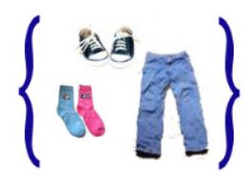
What Is Set?
Collection of something (কতগুলো জিনিস একত্রে করে রাখা)
Example: set
of clothes→
Elements of set

Slide 3
Mathematical Examples
Set of natural numbers: N= {1,2,3,4………..}
Set of all integers: Z={….-2,-1,0,1,2……….}
Set of all rational numbers: Q={…-2.5,-2.25,-2,….0,…. .25, .5, 1…….}
Set of real numbers: R={-3.1416, -2, 0…, pi,…..}
Set of Complex numbers: C={-1, -2, -i, …0, i , 2i, 1 ,2 ..}

Slide 4

Subsets
A ⊆ B means: set A is a subset of set B
Means→ either A=B or A is smaller* than B which does not contain any element absent in B.

Slide 5
Check This:
A= {1,2,3,4,5,6,7,8,9}
B= {1,2,3}
C= {0,1,2}
i) A ⊆ B → v) C ⊆ A
ii) B ⊆ A →
iii) A ⊆ A →
iv) B ⊆ B →

Slide 6
Proper Subset
A ⊂ B means→ A is smaller* than B (& OBVIOUSLY does not have any element absent in B)
Check previous slide again

Slide 7
QUESTION
What is the relation among N, Z, Q, R, C ?

Slide 8
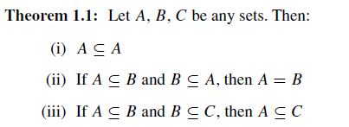
Book: Schaum’s outline

Slide 9
See details from book & lecture
Universal set
Empty set
Disjoint set
Venn diagram
Basic set operations (Union, Intersection, Complements, Differences, Symmetric Differences)

Slide 10

Fundamental Products

Slide 11
Check this: (pg:7, Schaum’s)
There are m = 2^{n} such fundamental products
Any two such fundamental products are disjoint
The universal set U is the union of all fundamental products

Slide 12
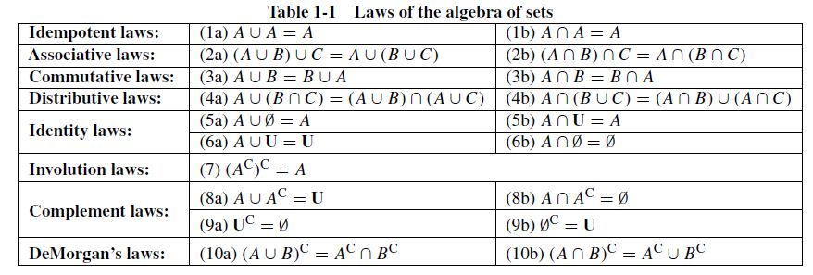

Slide 13
Duality
U ←→ ∅
∪ ←→ ∩
Just exchange them!
Remember “দ্যা মরগানের সূত্র” ? (DeMorgan’s laws)

Slide 14
Finite & Infinite Sets
Guess…
A= set of all English letters= ?
B= set of all integers= ?
C= [0,1] = ?
D= (0,1) =?
E={0,1} =?
∅ or { } = ?

Slide 15
Countable, Uncountable & Countably Infinite
Guess again….
E = {2, 4, 6, . . .} =?
I = [0, 1] = {x | 0 ≤ x ≤ 1} = ?
X= {1,3,5}=?

Slide 16
Guess
Finite → Countable:
Countable → Finite:
Infinite → Uncountable:
Uncountable → Infinite:

Slide 17
Answers
Finite → Countable: T
Countable → Finite: F
Infinite → Uncountable: F
Uncountable → Infinite: T

Slide 18
Counting Elements in Finite Sets
see Schaum’s (pg:8) and lecture

Slide 19
Inclusion–Exclusion Principle
I know that You know this topic ☺
-n(A ∪ B) = n(A) + n(B) − n(A ∩ B)
-what’s about n(A ∪ B ∪ C)?
-what’s about practising a math?

Slide 20
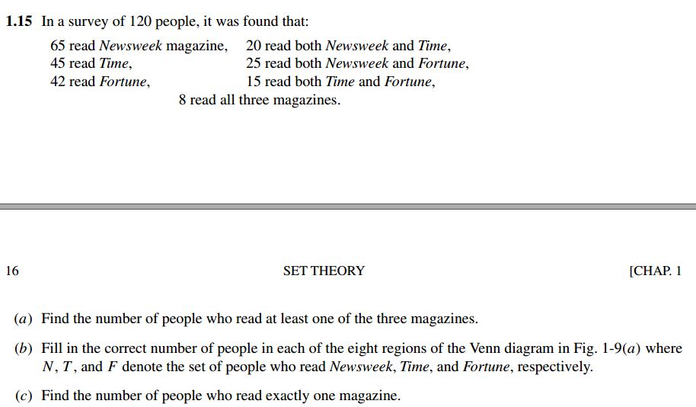
Try this

Slide 21
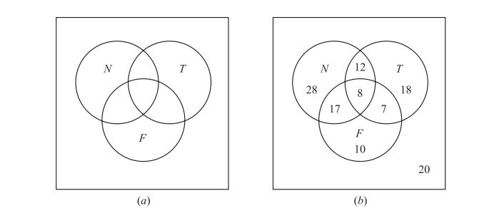
ANY QUESTION?

Slide 22
CLASSES OF SETS, POWER SETS, PARTITIONS (pg:10)
A = [ {1, 2, 3}, {1, 2, 4}, {1, 3, 4}, {2, 3, 4} ]
What is this! -_-

Slide 23
POWER SETS
see Schaum’s (pg:10) and lecture

Slide 24

PARTITIONS
Remember:
Subdivision into some nonoverlapping, nonempty subsets
2 IMPORTANT conditions→

Slide 25
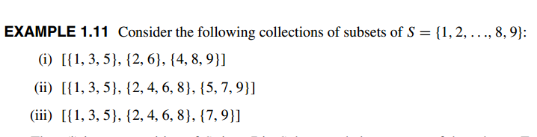
Check this:

Slide 26

Generalized Set Operations

Slide 27
Contd…
Check this→
A _______ collection of sets X= {{0,1}, {0,2},...., {0,n},{0,n+1},.....}
Intersection on X→ ?
Union on X→ ?

Slide 28
Same problem again !!!
A _______ collection of sets X= {(0,1), (0,2),...., (0,n),(0,n+1),.....}
Intersection on X→ ?
Union on X→ ?

Slide 29
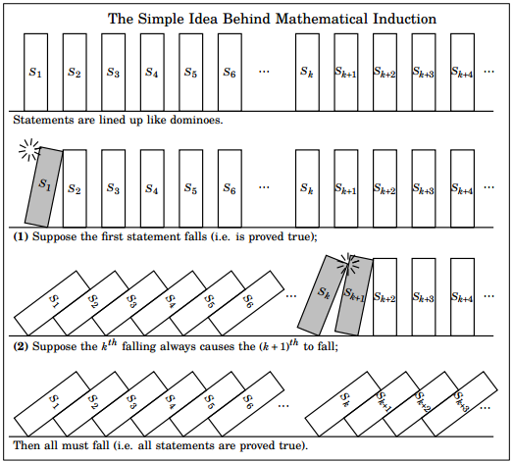
MATHEMATICAL INDUCTION
Again, I know that you know this topic ☺

Slide 30
THANK YOU
☺

